Slide 1

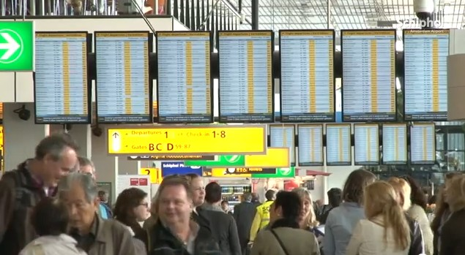
Samsung LFD solution proposal
Airport
[Schipol international airport in Amsterdam, Netherland]
Pre Sales Support part
Display Marketing Team
Samsung Electronics HQ
[Ver. 1.0] Last update : 20th Jun, 2012

Slide 2
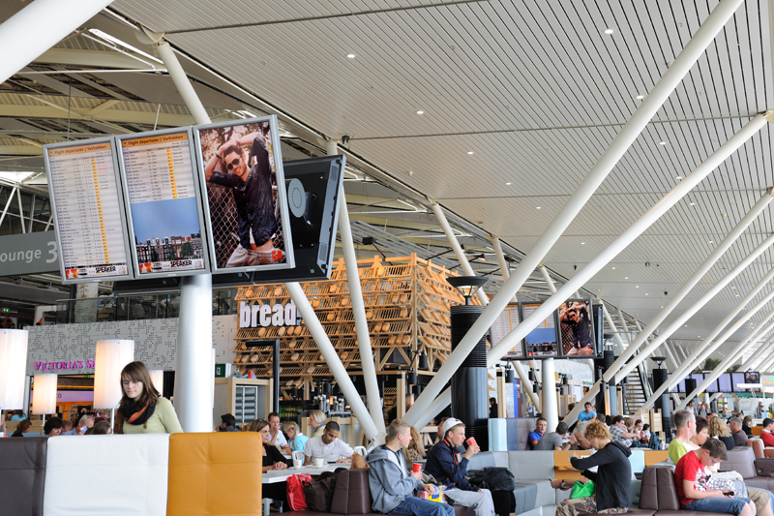
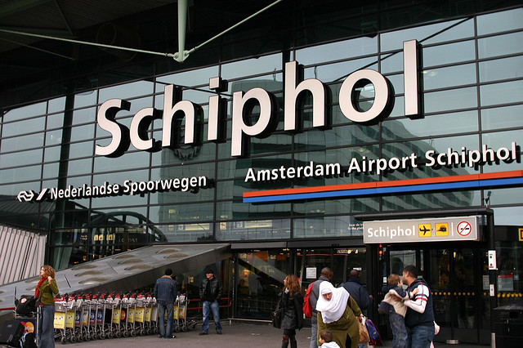

Samsung displays chosen again by Schipol airport
Schipol Airport
- Location :
Amsterdam, Netherland
- Total passengers
45,211,749 in 2010
- 5th busiest airport in EU
Schipol airport recently decided to install Samsung advanced LED displays
Samsung displays have been successfully operated for past several years

Slide 3
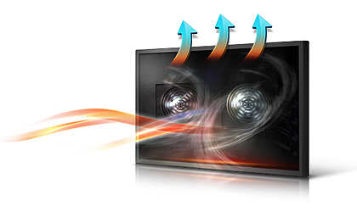

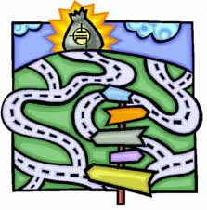





Challenges
High heat generation
Much higher heat conventional CCFL display generated cause external FAN cooling structure and excessively high total electricity cost
Frequent service issues
Airport do not allow far enough for service or technical treatment so display should be strong because it should be operated maximum 24hours
Low space utilization
Array of large flight information displays can make airport visitors feel stuffy and prevent them moving quickly
Technical risk
High security area like airport do not want take any risk to introduce unknown electronic device
Information delivery
Low contrast ratio and brightness can disturb clear information delivery, even worse with glare surface of screen under high illumination in public space
Split controls
Uniform control and protocol on different displays such as video wall or single will enhance technical efficiency
Product inconsistency
Technical characteristics required to be compatible in order for partial repair or change after some time passed from initial installation
Various size, requirement
As digital display market getting more popular, various displays with many different options are used
Notes:
3

Slide 4


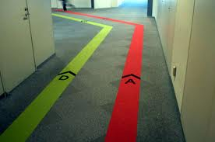
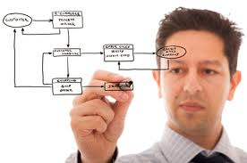



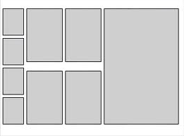
Benefits
Less heat, lower cost
About 70% less power LED display consuming comparing to conventional CCFL brings lower operation cost
High durability and reliability
Looks same with LED TV? Different quality standard for severe public environment
More flexibility with slim and light
Slim and light LED displays can give more flexibility to interior designer in order to maximize space efficiency
Experienced product
Accumulated technical know-how and many experience that working with various SI systems
Clear visibility with picture quality
High contrast ratio, brightness and wide viewing angle make sure clear visibility even though many people watching displays from different viewing angle
Uniform control
Unified solution for remote control program and protocols different types of displays
Consistency, backward compatibility
Compatibility will cause no worry if entire enclosure should be changed when changing one display out of array
Up to 75inch LED with P/G option
From 32 to 75 inch, from indoor to outdoor and from super narrow bezel for videowall to general displays with useful options
Notes:
4

Slide 5
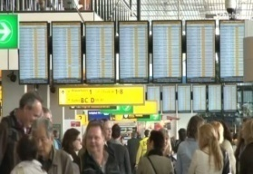
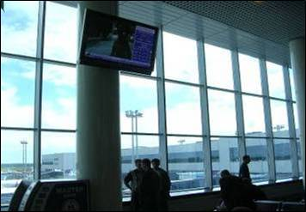
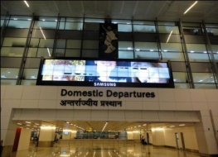
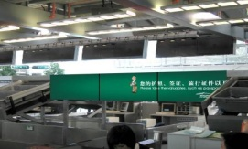
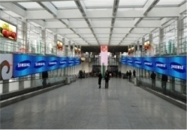
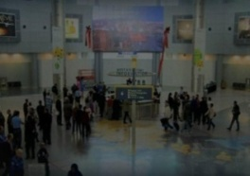
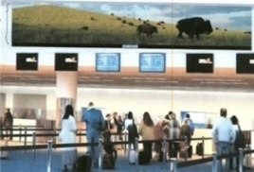
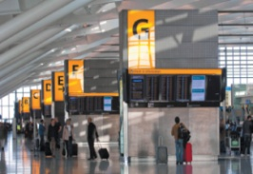
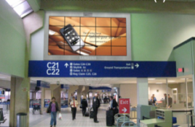
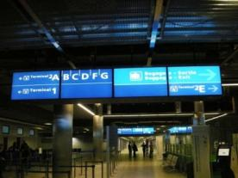
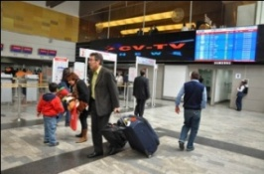
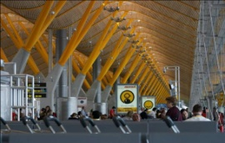
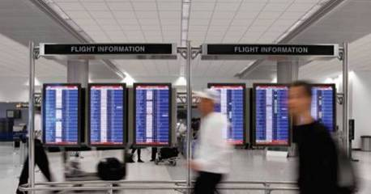
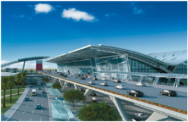
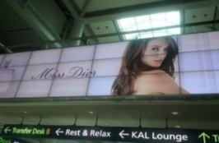
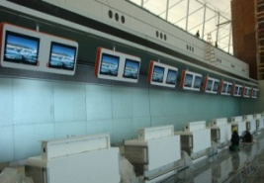
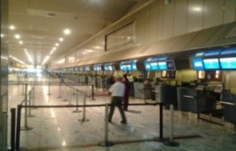
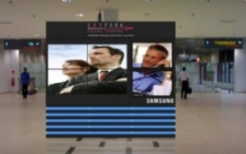
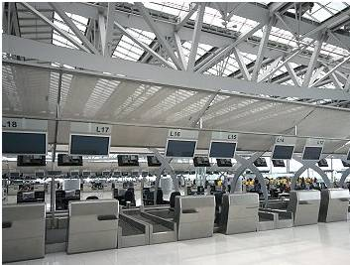
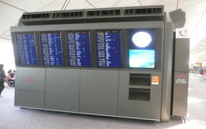
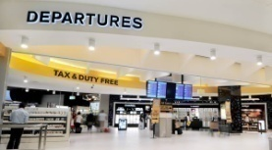
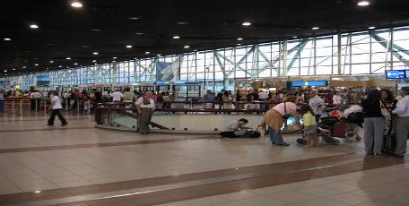
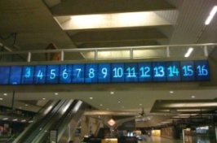
Samsung displays in world wide major airports
Amsterdam Schipol
Moscow
New Delhi
Guangzhou
Beijing
Las Vegas
Atlanta
London Heathrow
Dallas/Fort Worth
Paris CDG
El Dorado Bogota
Madrid, Spain
South West USA
Doha, Qatar
Incheon Seoul
Carrasco Uruguay
Johannesburg
Kuala Lumpur
Bangkok
Hong Kong
Sidney
Santiago Chile
Confins Brazil

Slide 6
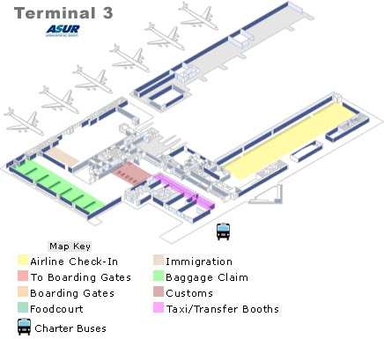
Samsung Solution Proposal
1. Check-in counter
2. Flight information display
3. Common waiting area
4. Passenger lounge

Slide 7
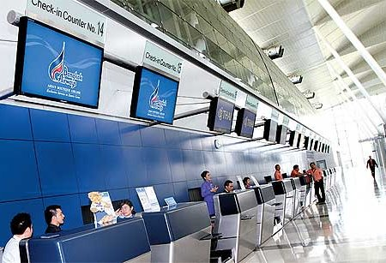
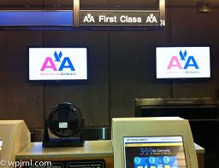
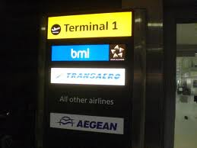
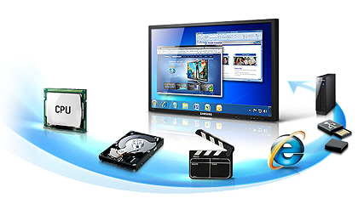
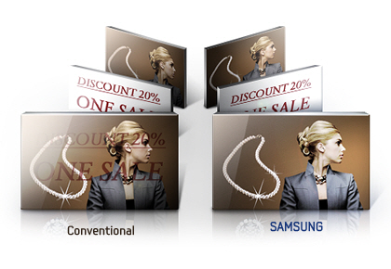
1. Check-in counter
User scenario
1. Mostly static content playing for a long time
2. Frequent contents change according to time slots in shared counter
[Bangkok international airport in Thailand]
Display should be
1. Strong enough to prevent any screen
burning and any defeat from long
time using
2. Easy content management method

Slide 8
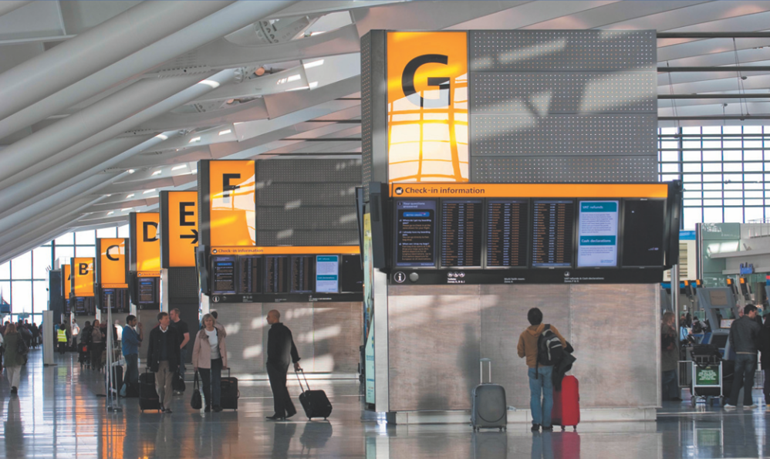
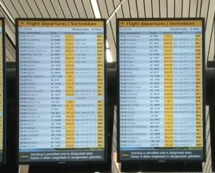
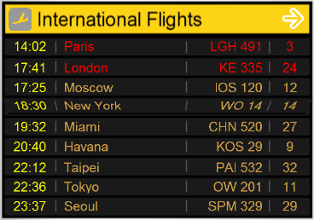
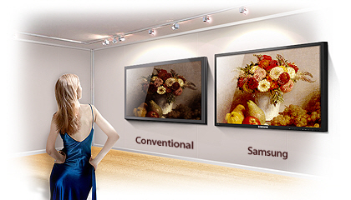
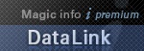
2. Flight information display
User scenario
1. Flight data shown from linked data server
2. Accurate and effective wordy information delivery
[Heathrow airport in London, United Kingdom]
Display should be
1. Data link solution ready to bring data from airport database on displays
2. Better picture quality with high contrast ratio make sure accurate information delivery even in crowded public area

Slide 9
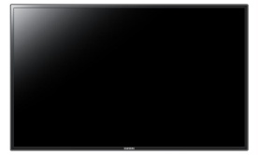
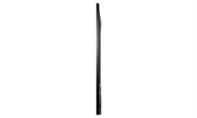
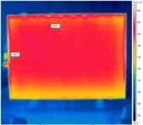
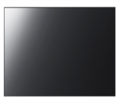
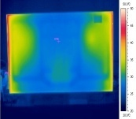

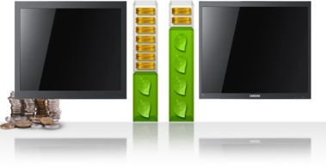
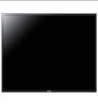
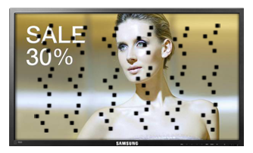








Solution proposal – 1. DE series
DE series
- Improved design suitable for convenient signage with slim, light eco-friendly for heavy usage
Low power consumption
Low operation cost
 | Usage | Inch
DE series (Non glare surface, matt bezel) | 24hours | 40,46,55
Anti-burning protection
→ Algorithm set
→ Specialized panel for extremely heavy usage
Overlay type touch module
with protective glass
• Magicinfo lite SW
→ No need to buy additional
media player
→ USB auto play
Slim and light
easy installation
maintenance cost saving

Slide 10







Solution proposal – 2. DX series
Professional Display
- Powerful performance display
equipped with good visibility
and high reliability
DVI Daisy chain
→ No distributor needed
Max. 100units available
 | DX series
Inch | 40”, 46”, 55”, 70”, 82”
Brightness | 700cd/m2
Powerful remote management
→ Monitoring and controlling
through Ethernet and RS232C
Superior picture quality
→ High brightness &
Full-HD resolution
Good visibility with low reflection
→ Non-glossy surface treatment
Professional DID
→ 24 hours & 7 days
operation available
SIM(Slide In Module) PC option
→ From high-end quad core PC to dual core PC module with flexibility

Slide 11






Solution proposal – 3. Data link solution (1/2)
Solution overview
Polling data from DB
Data link server
Airport database
Network
Content creation
Admin jobs
Template controls
Content register
Magicinfo server
Content author
Magicinfo client
Compatible with mostly used data base language as module base
: Oracle, MS-SQL and can be added up depending on customer demand
DATA substitution possible
example : text to image, text to movie

Slide 12




Solution proposal – 3. Data link solution (2/2)
Content creation
by Samsung Authoring tool
Data linking definition
by Samsung Magicinfo server
Display linked data on screen simultaneously
by Magicinfo client
Flight information DB polling set-up
by Magicinfo dataLink

Slide 13

Success case
New Doha international airport
2300 units DE series
Usage
Flight Information display in all around airport area
Deal Summary
- High reliability for severe public environment was needed
- Required stylish design harmonic with newly built airport interior
- Powerful remote management system requested
Key Success Factor (Winning Point)
- LED display designed for 24 hour operation
- Technical support and pre-sales activity for customization requirement
- MagicInfo S/W optimized for Samsung LFDs

Slide 14


Success case
Atlanta international airport
Quantity : 108 units (UE46A)
24 units (550EXn)
Usage : Passport Control Center
Others : 3 x 12 Video Wall (3)
Deal Summary
- Atlanta Airport has the highest traffic in the world
- Contents Provider PMT took charge of the project as prime contractor and purchaser
- Maximized brand and product exposure
- Given priority for supplying LFDs for the new airport terminal under construction (120 units)
Key Success Factor (Winning Point)
Superior LED product quality compared to competitors
Quick response and support provided to PMT and the City of Atlanta

Slide 15



Success case
Hong Kong international airport
1700 units
Usage
Flight Information/Baggage Allocation/Check-in Counter/Boarding Gate Signage/Advertising Panel
40”, 46” DX series
High brightness and 24hours operation quality
Carrasco Airport, Uruguay
400 DXn: 140 Units
Usage
Flight Information/Baggage Allocation/Check-in Counter/Boarding Gate
Carrasco Airport became a major hub airport in Uruguay

Slide 16






3. Common waiting area
Overwhelming digital monument reminds long-lasting brand identity
Samsung Super Narrow Bezel
46”, 55” UD series
B to B : 5.5mm
700 cd/m2
3.7mm(U/L)
1.8mm(R/B)
Narrow bezel
More information with seamless
[Las Vegas international airport in USA]
Convenient calibration tool
Easy adjustable color uniformity
Magicinfo Videowall
Professional digital signage software
[El Dorado Intl’ Airport, Bogota, Columbia]

Slide 17





3. Common waiting area
Overwhelming digital monument reminds long-lasting brand identity
Samsung Built-in Touch Display
TS series
32”,40”,46”,65”70”,82”
Touch ready to use
Built in touch module
Cost saving without additional device
Slide in PC option
[Samsung mobile kiosk]
Touch overlay accessory
ME series (32”, 40”, 46”, 55”, 65”, 75”)
DE series (40”, 46”, 55”)
Attachable structure on LED display
[Vodafone store, UK]
[Parco department store, Japan]

Slide 18













Solution proposal - Magicinfo software
Videowall2
Videowall2
Up to 250 video wall display
Compile and edit scenes instantly
Irregular type video wall
Real time data & content management
Creative authoring tool
Mobile server control
Simple and intuitive user interface
Local scheduling on OSD
USB auto play

Slide 19









4. Passenger lounge
Digital hospitality with ultimate multi touch experience
Samsung SUR40 Solution
40” SUR40
Max.52 multi touch
Object recognition
50 points of contact simultaneously
Interact with people
[Red MR KTV, Hong Kong]
Optical tag recognition
Exclusive PixelSense™ technology
Integrated Sensors and IR LEDs
[First National Bank,
South Africa]
[Vodafone premium shop, Germany]

Slide 20

Success case
Beijing international airport(T3)
Model : UE46A, SBB
Quantity : 500 Units
Usage : Advertisement in the
hallway (both-ways)
between T3 and car park
Mega advertisement display (takes 2 minutes to walk pass the displays)
Deal Summary
- End User : Beijing Airport T3
- Distributor : Jinshilianqiang (金世联强）
- Annually 80 million people uses the terminal 3
- Reference case of mega-display project to be utilized in similar projects
Key Success Factor (Winning Point)
- Engaging B2B professional sales person to the existing customer and disty. (Relationship sales)
Existing install-base (Beijing Olympic park, underground shopping mall) made good impression to
the customer

Slide 21


Success case
New Doha international airport
2300 units DE series
Usage
Flight Information display in all around airport area
Deal Summary
- End User: TIMDA
- Distributor: Ingram
Solution: Used for their digital Signage and Pathway
Key Success Factor (Winning Point)
Loyal relationship with TIMDA and Scala.
Complete End-to-End Solution to keep competitors out
- Pre-Sales activity along with great technical support

Slide 22

Success case
Guangzhou Airport
Product
460UX: 320 Units
Use for
Commercial billboard at Domestic & Int’l
Deal Summary
End User: Guangzhou airport
Solution: Narrow bezel display with high performance
Key Success Factor (Winning Point)
Product Competitiveness (Ultra Slim Bezel)
Strong relationship with key stack holder
Air Media recommend Samsung to Beway, Air Media is Samsung’s key account
Beijing Airport 820DXn & 700DXn)

Slide 23
Value of Samsung LFD
1. LED Solution

Slide 24
Embedded media player (1/2)
Internal CPU, memory and storage inside
Conventional display
+ PC
+ S/W
100
25% cost down
Samsung LED display
75
Optimized Light usage operating system based Samsung SOC
Notes:
내장형 미디어 플레이
삼성 LED 제품을 구입했다면, PC를 구입했다고 할 수 있습니다.
내장형 미디어 플레이어와 운영 S/W로 약 25%의 비용을 절감할 수 있습니다.

Slide 25



Embedded media player (2/2)
Player & S/W inside in Samsung LED display
Without any additional device
. Media contents playing supported
Magicinfo Lite S/W
. Provide digital signage user experience
Image
Notes:
추가적인 장비나 PC 없이 비디오, 플레쉬, PPT, 이미지 파일을 재생할 수가 있으며,
로컬이나 서버를 통해 운영이 가능한 S/W를 제공합니다.

Slide 26


Local controlling
Simple and intuitive UI only with remote controller
Local S/W management require only remote controller
Also easily copy media contents from external USB memory
Notes:
삼성 LED가 제공하는 운영 S/W인 magicinfo lite의 UI는 단순하고 직관적입니다.

Slide 27
Slim depth
Save about 40% construction cost
Construction
cost
40%
[Conventional]
[LED]
 | Conventional (CCFL) | LED
Construction | Dug-in | none
Labor cost | High | Low
Building remodeling | Yes | No
Wall mount | Strong enough for display weight | Wire type
[Conventional]
[LED]
*Based on Samsung internal data
Notes:
삼성 LED 제품은 제품 두께가 29.9mm 로 얇기 때문에 설치시 공사비가 적게 듭니다.
기존 제품은 제품 두께로 인해 벽파기 공사를 해야 했지만 삼성LED 제품은 필요가 없습니다.

Slide 28

Light weight
Reduce cost on installation and maintenance
32%
cost
Conventional
22.8 kg
LED
12.5 kg
[Conventional]
[LED]
Only 60% weight to conventional
Up to 32% manpower cost saving for installation & maintenance
Model | Conventional | LED
Manpower | 2.5 people | 2 people
Average time (h) | 0.4 | 0.2
Cost for 1 unit*** | $20 | $8
Cost for 100 units | $2,000 | $800
Maintenance | Conventional | LED
Manpower | 2 people | 1 person
Average time (h) | 0.2 | 0.2
3 years operation (h)** | 1.2 | 1.2
Cost for 1 unit*** | $48 | $24
Cost for 100 units | $4,800 | $2,400
*Based on Samsung internal data
**Assume every 6 months maintenance conducted
***Assume manpower cost per 1 hour be $20
Notes:
삼성LED 제품은 가볍기 때문에 설치 및 유지관리 비용이 절감됩니다.
비용 계산
- 가정 : 1인당 20달러 인건비, 6개월에 한번씩 보수

Slide 29





Eco-friendly LED (1/2)
Reduce half of electricity cost
Conventional
290 watts
LED
160 watts
Model | CCFL | LFD
Power consumption ( 1 unit) | 290 Wh | 160 Wh
Power consumption (16units 4x4 ) | 4,640 Wh | 2,560 Wh
Power consumption for 1 day (16 hour operation) | 74 KW | 41 KW
Power consumption for 1 year | 27 MW | 15 MW
Electricity cost per 3 years | $ 8,667 | $ 4,494
*Based on Samsung internal data
***Assume manpower cost per 1 hour be $20
Notes:
발열량이 적기 때문에 전기료를 절반으로 절감할 수 있습니다.

Slide 30


Eco-friendly LED (2/2)
Less air conditioning cost & thermal restriction
7% more power needed for cooling down 1°C
MS retail store save about $10k electricity cost per a month after changing to UE
Model | Conventional | LED
Power consumption (Wh) | 290 | 160
Heat generation (BTU*) | 988 | 545.6
* BTU : the amount of energy needed for heat up 1°F for 1 pound of water
Notes:
또한 발열량이 적기때문에 제품이 설치된 방에 룸 에어컨디셔닝 비용을 절감할 수 있습니다.
통계에 따르면 1도를 낮추는 데 약 7%의 전력이 더 필요함

Slide 31



Wireless communication
Wireless connection supported with dongle
Concept
Biz. Benefit
Wireless dongle from Samsung
. Model name : WIS09ABGN
Construction work needed in ceiling or wall for wired connection
80% Less installation cost*
Installation | Wired | Wireless
LAN cable (10m) | $10 | 0
Repeater (1 to 1) | $40 | 0
Switch (24port) | $70 | 0
AP (300Mb/sec) | 0 | $40
Construction work Per 1 line including labor | $200 | 0
Cost per 1 unit | $320 | $40
[USB terminal on the rear side]
*Detail cost need to be calculated for each case
Notes:
고객의 편의를 위해 무선 동굴을 이용한 원격 제어 기능도 지원합니다.
특히 유선 LAN 공사가 필요한 건물에서는 이 기능을 사용하면 설치 비용을 크게 절감할 수 있습니다.

